Slide 1

Introduction to Information Geometry
Frank NIELSEN
July 2022
https://franknielsen.github.io/IG/index.html

Slide 2
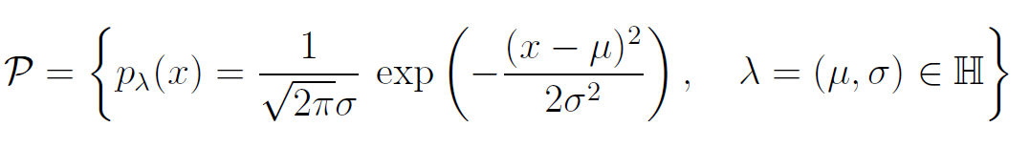
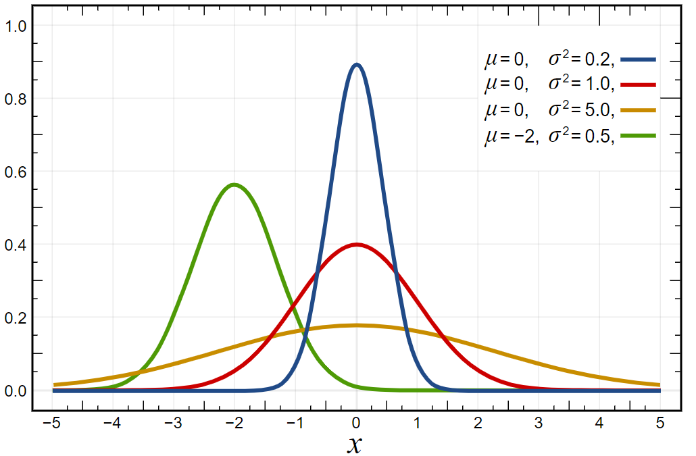
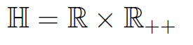
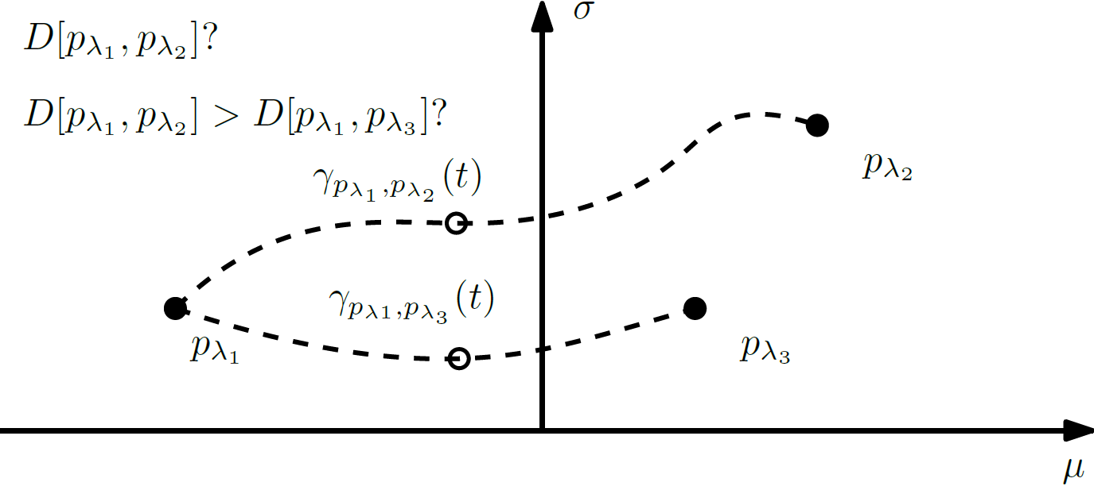
What is information geometry? (1/4)
Consider a set of parametric probability distributions called the statistical model
For example, the set of normal distributions with mean μ and variance σ²
Parameter space Λ is the upper plane
What kinds of geometric structures for this family of normal laws?
A few related questions:
How to interpolate between two normals?
How to define distances between them?
Are they several ways to proceed?
If so why? And how to choose the right structure?
Notes:
à é è ç ê

Slide 3
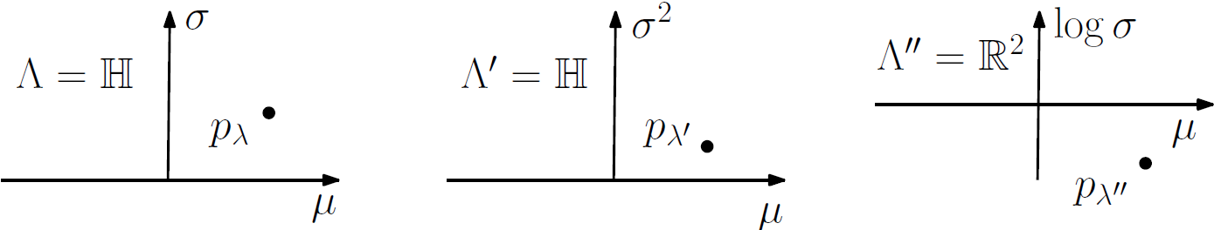
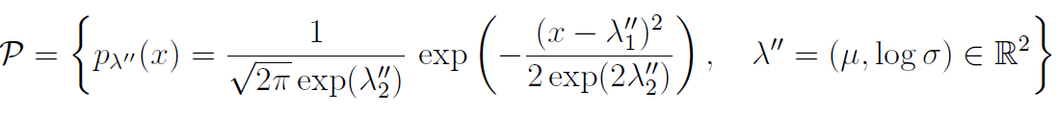
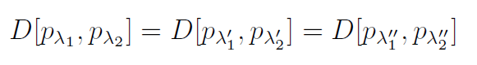
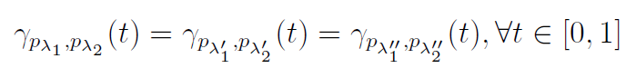
What is information geometry? (2/4)
Which invariance principles shall be satisfied by the geometric structures and the distances between statistical models
First invariance principle: If we parameter Gaussians by (μ,σ²) or (μ,log(σ)) instead of (μ,σ), it should not change their distances nor the interpolating paths called ``geodesics''
Euclidean distance
between parameters
not invariant!
Same family of Gaussians
Thus we need these
two invariance properties:
①
②
Notes:
à é è ç ê
FigIpe-NormalDomains.pdf

Slide 4
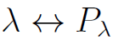
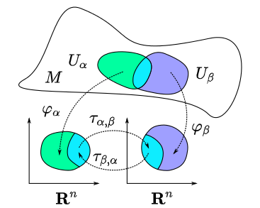
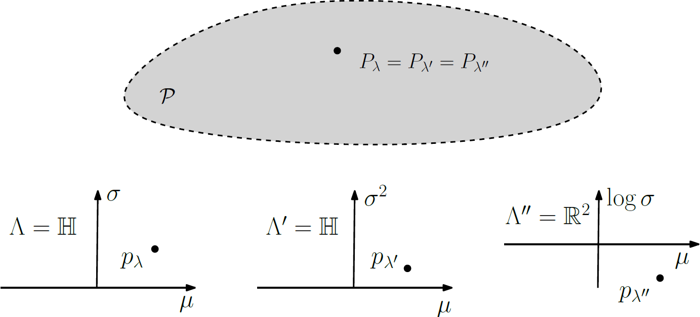
Differential geometry of statistical models
To each point of the manifold corresponds a unique parametric distribution:
Statistical model is identifiable when
Often a single global chart = atlas which covers the parameter domain
Abstract figure
depicting a manifold
© wikipedia
Domains
In general, need several local charts
to cover a manifold
(eg., two charts for the sphere)
Several global charts (atlas with a single chart)
Notes:
à é è ç ê

Slide 5
What is information geometry? (3/4)
Information geometry: study geometric structures on the manifold induced by identifiable statistical models
Use language of geometry: geodesics, balls, information projection, statistical curvature and the tensor calculus. This tensor calculus made possible to study the efficiency of statistical estimators to higher order.
Study the principles of invariance in statisticcs
The new dual geometric structure can also be used beyond the statistical scope (pure geometry). For example, the information-geometric structures have been used to analyzed interior point methods in optimization
Information geometry was born from the mathematical consideration of the Fisher metric and its induced geodesic distance to solve classification and statistical hypothesis test tasks
[Mahalanobis 1936] [Hotelling 1930] [Rao 1945]
Notes:
à é è ç ê
(eg., en optimization avec des fonctions de barriere).

Slide 6
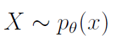
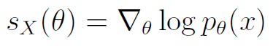
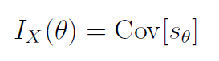
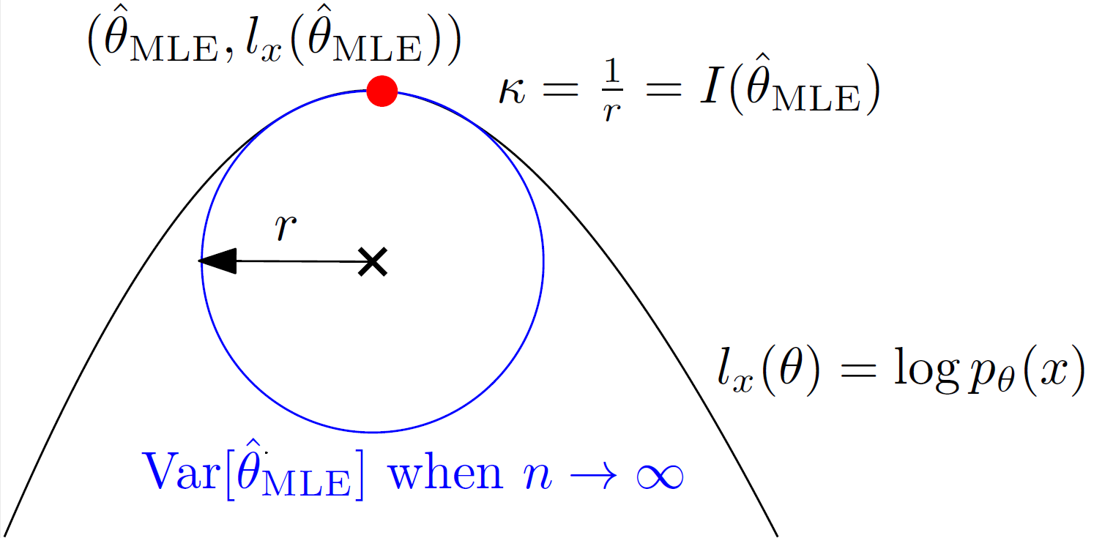
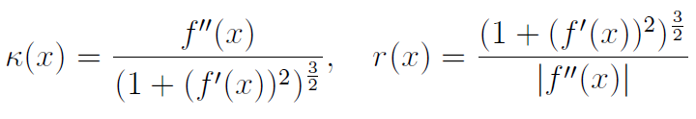
Fisher information I_{X}(θ)
Consider a parametric family of laws indexed by D parameters Fisher Information Matrix (FIM) = covariance matrix of the score
FIM is symmetric and positive semi-definite (could be undefined too)
FIM is said regular when positive-definite (yields the Fisher metric on manifolds)
Interpreted as the curvature of the log-likelihood function:
For a general function f(x), the curvature is defined as
MLE: Maximum Likelihood Estimator
Radius of the osculating circle corresponds
To the inverse of the absolute curvature
Asymptotic normality of the MLE (Cramér-Rao lower bound)
Notes:
à é è ç ê
Borne de Cramér–Rao

Slide 7
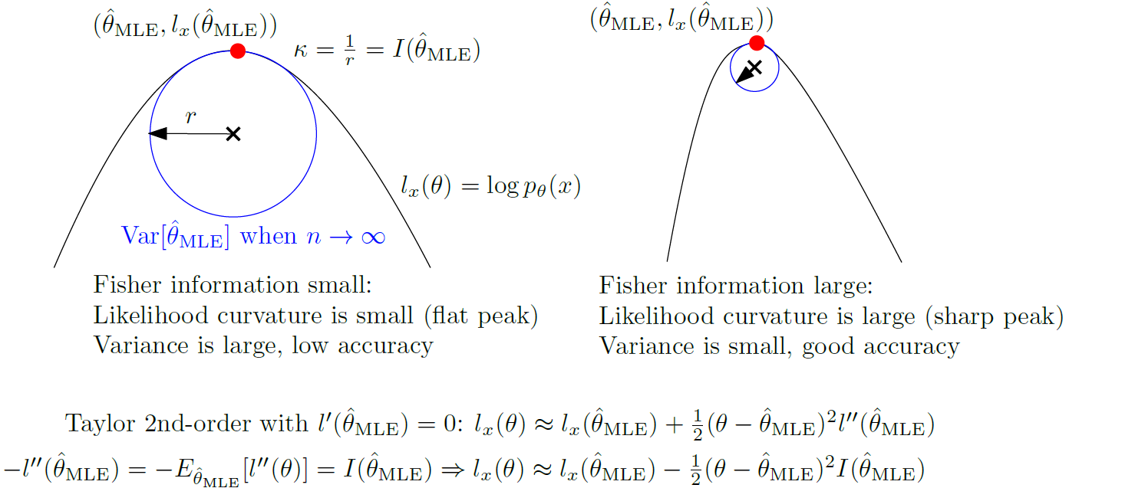
Fisher information I_{X}(θ)

Slide 8

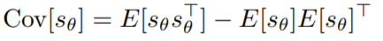


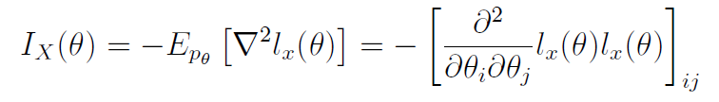
Two usual expressions of the Fisher information
Using the first two Bartlett identity under the regularity condition that we can exchange k times the differentiation with the integration operations, we get
Allows to rewrite the FIM under it is most famous forms:
(Bartlett k)
① First form:
(Bartlett k=1)
② Second form (negative of the Hessian of the log-likelihood) :
(Bartlett k=2)
Notes:
à é è ç ê
①②

Slide 9
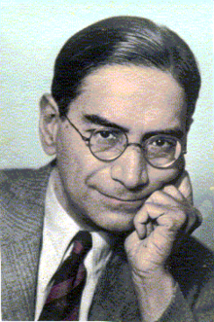

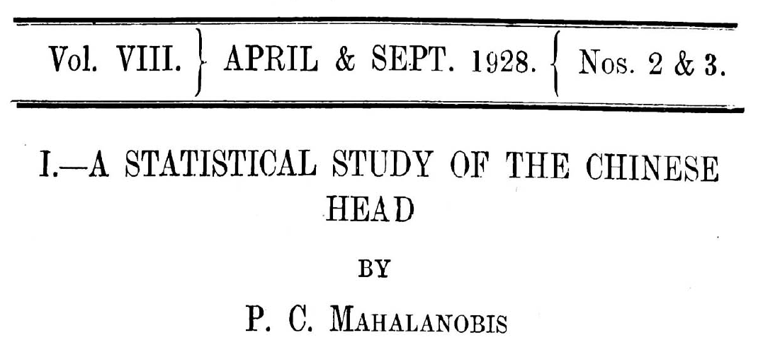
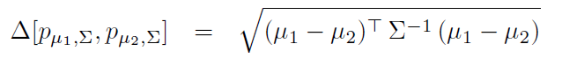
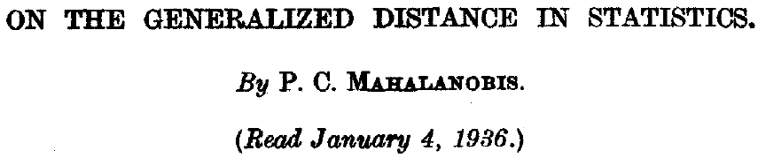
Mahalanobis and his generalized distance
Motivated by the statistical analysis of human skulls collected in various regions. Each skull is characterized by d.
Mahalanobis (1928, 1936) introduced the following D2 statistics and divergence entre deux groupes S₁ et S₂ :
Nowadays the metric Mahalanobis distance:
Divergence = smooth dissimilarity which may be asymmetric and may not satisfy the triangular inequality of metric
© wikipedia
P. C. Mahalanobis
(1893-1972)
Found of the
Indian Statistical Institute (ISI)
Precision matrix = inverse covariance
Generalized the Euclidian distance when Σ =I, the identity matrix
Notes:
â à é è ç ê

Slide 10
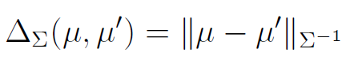
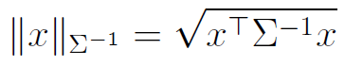
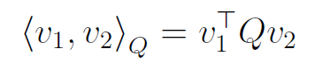

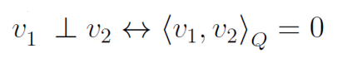
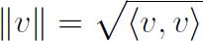
Mahalanobis distances: Vector spaces equipped with an inner product
Mahalanobis distance rewritten as
For a symmetric positive-definite matrix (SPD) Q, we define the
inner product by the following bilinear form:
Inner product induces a norm which in turn induces a metric distance:
Inner product allows us to define the orthogonality between two vectors (and their subtended angle) and the vector lengths:
This geometry corresponds to the extrinsic geometry of tangent spaces of manifolds
Notes:
â à é è ç ê

Slide 11
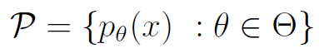
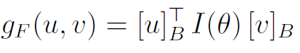
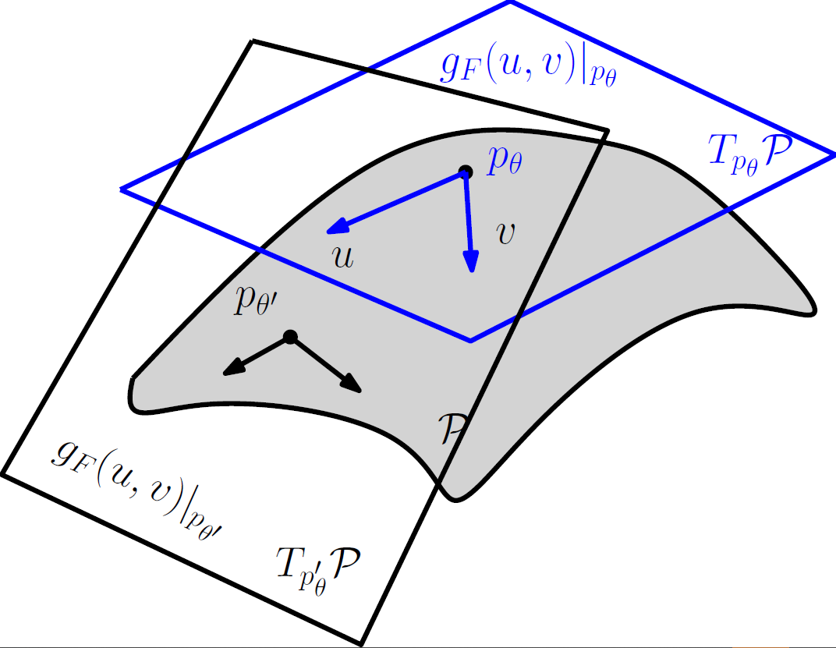
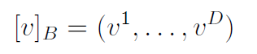
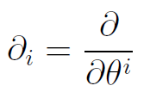
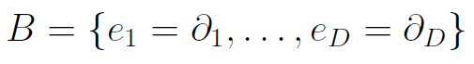
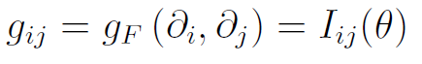
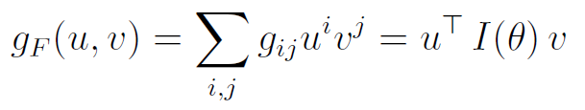
Riemannian Fisher metric tensor field aka Fisher metric
Consider the manifold
g_{F} : smooth fields of inner products on tangent planes
vector components
expressed in the natural basis of the tangent plane
Induced by the (local) chart θ(.)
Notes:
â à é è ç ê
La borne de Cramér–Rao pour un estimateur non-biaisé & inverse MIF
Ordre partiel de Löwner des matrices SPDs :

Slide 12
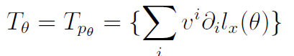
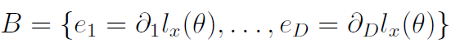
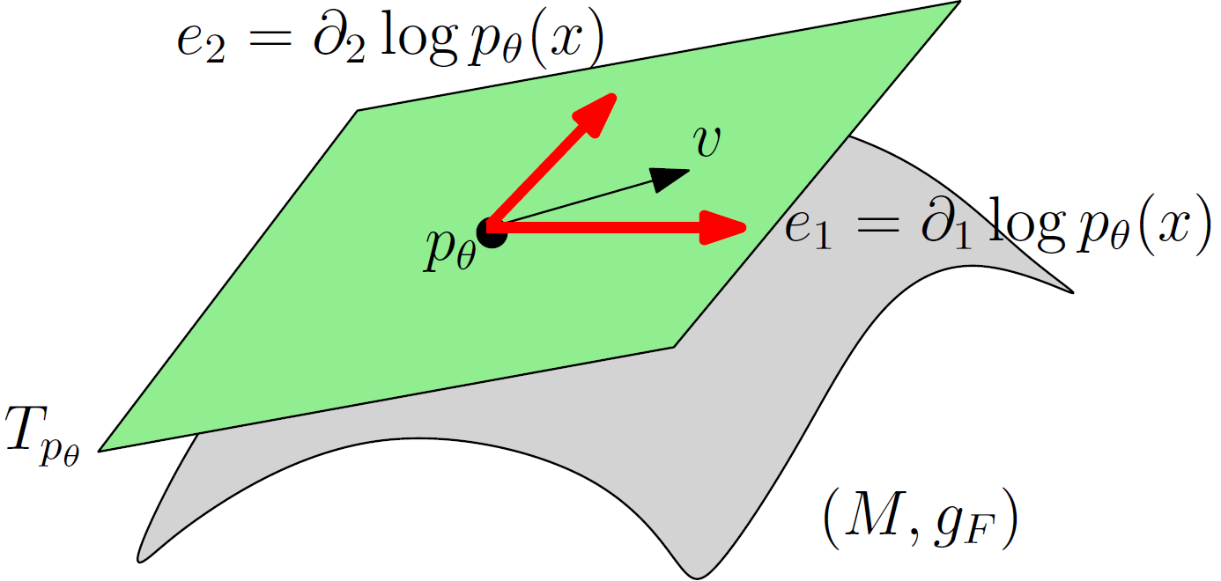
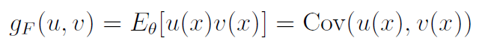
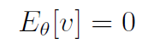
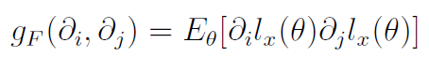
Tangent plane representation for a manifold induced by a statistical model: Reinterpret the inner product
On a tangent plane, we can choose any arbitrary basis to express vectors
Inner product of two vectors is independent of the choice of basis: the component vectors depend on the basis but the vectors are geometric objects
Express a vector v by a representation v(x)
Basis vectors of T_{θ} can be chosen as the score vectors:
The inner product can be reinterpreted as:
Bartlett I
Expectation
Notes:
â à é è ç ê
Plan tangent = espace produit scalaire

Slide 13
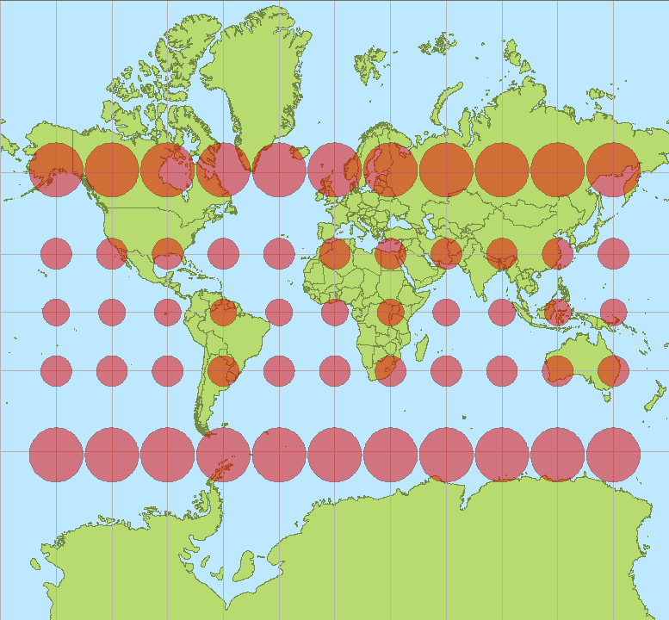
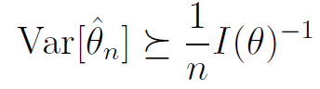
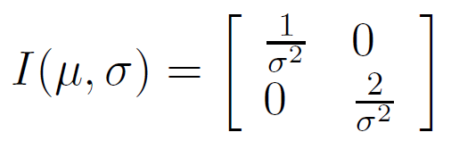
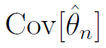
Visualizing the Fisher metric and the Cramér–Rao bound
Fisher metric:
Visualize I(θ) by an ellipsoid
Visualise the metric tensor field by
Tissot indicatrix
Visualizing the Cramer-Rao lower bound :
For each grid position (μ,σ) :
- Sample iid N (μ,σ)
- Maximum likelihood estimator of (μ,σ)
Repeat k times to get an empirical estimator of the covariance matrix of the 2D parameters.
Converge to the scaled inverse FIM
© wikipedia
Mercator projection
Inverse of the FIM displayed with Tissot indicatrix
Upper plane (μ,σ)
Notes:
â à é è ç ê

Slide 14
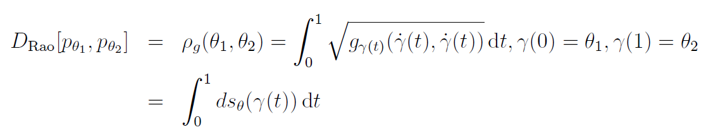
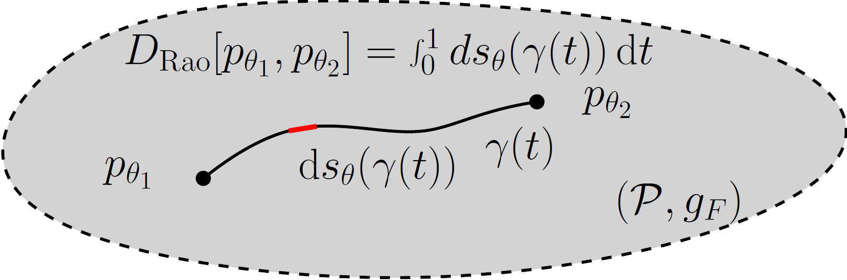
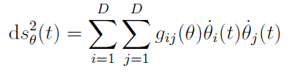
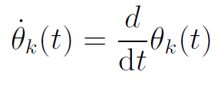
Rao distance on the Fisher-Rao manifold
Here, γ is the Riemannian geodesic
(or add a minimizer on all paths γ)
Length element
In practice:
Need to calculated geodesics which are curves locally minimizing the length linking two endpoints (equivalently minimize the energy of squared length elements)
Finding Fisher-Rao geodesics is a non-trivial tasks: No-known closed-form for the Fisher-Rao geodesic/distance between multivariate Gaussians!
Notes:
â à é è ç ê

Slide 15




Invariance under reparameterization of Rao’s distance
Consider two different parameterizations of a statistical model:
Covariance transformation of the FIM under reparameterization
... However the length element is invariant :
So that the Fisher-Rao distance is invariant :
⮞ This is the first principle of invariance of information geometry
Notes:
â à é è ç ê

Slide 16






Fisher-Rao geometry of univariate normal distributions
INVARIANT
INVARIANT
Fisher metric
Rao’s distance or
Fisher-Rao distance
stretched Poincaré half-plane
FIM and domains
for various
parameterizations
COVARIANT
COVARIANT
In general, location-scale families yield a hyperbolic Fisher-Rao geometry
Notes:
â à é è ç ê

Slide 17


Fisher-Rao manifolds: Intrinsic vs extrinsic viewpoints
A Riemannian manifold of dimension D can be embedded as a surface of Euclidian space in dimension O(D²) :
Isometric embedding of the manifold
For example, Rao’s distance between two Bernoulli distributions or categorial distributions can be easily found by embedding the standard simplex on the positive orthant of the 1D sphere of radius 2 in R2 by the 2 x square root transformation
Covariance transformation of the FIM
Parameter space
Intrinsic Fisher-Rao manifold
of dimension 1
(Bernoulli family )
Fisher-Rao manifold
Extrinsic
Embedded in R²
Notes:
â à é è ç ê

Slide 18





Neuromanifolds and deep learning
Parameter space θ :
Connection weights+bias
A neural network (like the multilayer perceptrons, MLPs) is described by a feed-forward architecteur by means of a large number of parameters θ
Consider stochastic neural networks (SNNs) with noisy output:
Neuromanifold is
Maximizing the likelihood of a SNN with Gaussian noise amounts to minimize the mean quadratic error
Given a training set, we learn the parameter of the NNs using gradient descent. We can visualize the learning process as a trajectory on the neuromanifold modelling the parameter space. We observe plateau phenomena when nearning a singularity on the manifold where the Fisher information matrix is rank deficient or close to (small eigenvalues of the FIM).
... Eg a Gaussian noise:
Artificial
Neural Network
Modelled by a
neuromanifold
Learning trajectory
[SN 2017]
Notes:
â à é è ç ê ù

Slide 19




Natural gradient: Steepest Riemannian descent
Ordinary gradient descent (GD) method for minimizing a loss function E(.) :
Learning step or rate
Ordinary GD depends on the parameterization
Plateau phenomena near singularities (almost degenerate Fisher information)
Natural gradient is invariant to reparameterization and avoids plateaus:
Natural gradient descent (NGD)
Where α = step size
Natural gradient descent is different from the Riemannien gradient descent which
relies on the Riemannian exponential map which is time consuming (retraction)
Notes:
â à é è ç ê ù û

Slide 20

What is information geometry? (4/4)
A dual structure which allows to explain the duality between statistical inference like the maximum likelihood estimator and a family of statistical models obtained from the maximum entropy principle: Information geometry explains the link between Shannon entropy, the Kullback-Leibler divergence and exponential families in statistics.
Second principle of invariance by sufficient statistic
This core dual structure of information geometry:
Open new perspectives: For example, non-extensive entropies like Tsallis entropy, complex systems, conformal geometry of deformed exponential families, etc.
Many applications of information geometry ranging from signal processing (Radar, Brain-Machine interfances, etc. ), to medical imaging, to machine learning and AI, etc.
x ∈ sample space Ω
Notes:
â à é è ç ê ù û

Slide 21





Geodesics are defined according to affine connections
In Riemannian geometry, geodesics are locally length minimizing curves
Geodesics γ(t) defined by connection ∇ as ∇-autoparallel curves:
where ∇_{X}T is the covariant differentiation operator and X is a vector field
D³ Christoffel symbols Γ which are functions characterizing the affine connection ∇ (covariant derivative)
In Riemannian geometry, we use by default the Levi-Civita connection which is derived from the metric tensor field g (thus implicit in Rie. Geo.) :
Notes:
â à é è ç ê ù û

Slide 22

Affine connection ∇ : Visualizing the curvature by the
∇-parallel transport along smooth loops
© wikipedia
Élie Cartan
1869-1951
© CNRS
© CNRS
Cylinder is flat, 0 curvature
Sphere has positive constant curvature
A connection is flat is there exists a coordinate system θ for which the Christoffel symbols all vanish: Γ(θ)=0
⟶ Geodesics are plotted as line segments in the local chart θ
Geodesics of flat connection
=
Line segments
Notes:
â à é è ç ê ù û
https://images.math.cnrs.fr/Visualiser-la-courbure.html?lang=fr

Slide 23





The key dual structure of information geometry
such that
Given a torsion-free affine connection∇ and a metric tensor g, we can build a unique dual torsion free connection ∇* such that the metric is preserved by the bi-parallel transport
The dual connection of the dual connection is the original connection
Question: How to find meaningful dual connections?
Method of Amari-Nagaoka (1982) : the statistical expected α-connexions (Chentsov 1972)
Method of Eguchi (1983): Build dual connections from dual divergences (contrast functions)
Notes:
â à é è ç ê ù û

Slide 24





The dual α-geometry of Amari and Nagaoka
Structure
Dual connections with respect to Fisher metric
∇^{α}
Defined by the Christoffel symbols
Some α-connections:
0-connection = Levi-Civita metric connection of Fisher metric : Fisher-Rao mfd
1-connection is called the exponential connection [Efron 1975]
-1 connection is called the mixture connection [Dawid 1975]
Dual geometry em used to study the duality between estimators/stat models
Notes:
â à é è ç ê ù û

Slide 25







Eguchi’s dual geometry induced by a divergence
Divergence information geometry
(self dual when divergence is symmetric)
Structure
Get a divergence (contrast function) from a statistical divergence between parametric distributions. For example, the Kullback-Leibler divergence between two parametric distributions from a family P:
Eguchi Levi-Civita metric associated to D is
Eguchi connection associated to D
Define the dual divergence en by swapping the parameter order:
Get dual affine connections
Parametric divergence
contrast divergence
Statistical divergence
-
Levi-Civita connection is recovered from
Notes:
â à é è ç ê ù û

Slide 26








f-divergences and their induced connections
Relative entropy or the Kullback-Leibler divergence belongs to a broader class of dissimilarities : f-divergences [Csiszar'63] [Ali&Silvey'66]
Generator f(.) is convex, strictly convex at 1.
WLOG, fix f'(1)=0 et f''(1)=1 to get a standard f-divergence
Dual f-divergence with
The Eguchi induced metric tensor of std f-divergences = Fisher :
Induced f-connections wrt to f-divergences between distributions of a family P match with the α-connections of Amari and Nagaoka :
Separable divergence
Notes:
â à é è ç ê ù û ï

Slide 27






Statistical distances and information monotonicity
Consider a transformation Y=t(X) on random variables between two measurable spaces (deterministic or stochastic, Markov kernel):
Second principle of invariance: We should not increase the power of discrimination of divergences by a transformation:
Fisher information monotonicity:
Equality holds if and only if t(X) is a sufficient statistic
A sufficient statistic summarizes all necessary information for inference on the parameter θ (statistical lossless compression):
Theorem: f-divergences are the only separable monotone divergences
Notes:
â à é è ç ê ù û ï
c'est-à-dire

Slide 28





Exponential families have finite dim. sufficient statistic vector
An exponential family is a set of parametric distributions with density which can be expressed canonically as :
whereF is an analytic and stricty convexe and differentiable function:
(eg., Lebesgue or counting measure)
By default, scalar product = Euclidean inner product
Natural parameter space for full EFs
F : log partition function or cumulant function
Notes:
â à é è ç ê ù û ï

Slide 29








Information geometry of exponential families: Dually flat
Statistical model: natural exp. family
or more generally
Exponential connection and dual mixture connection are both flat:
Dually flat spaces of exponential families :
Fisher information metric is a Hessian metric
By using the Legendre-Fenchel transformation, we get a dual coordinate system eta
Moment or mean parameterization:
Fisher information matrix can be expressed in the moment parameter:
Notes:
â à é è ç ê ù û ï

Slide 30




Dually flat spaces with Hessian structures
The primal and dual geodesics are line segments in the affine theta and eta coordinate system:
In dually flat spaces, there is a canonical divergence: The Bregman divergence. For exponential families, this Bregman divergence amounts to the dual divergence of the Kullback-Leibler divergence (=reverse KLD) between corresponding densities :
Primal geodesic
Dual geodesic
Notes:
â à é è ç ê ù û ï

Slide 31


Visualizing a Bregman divergence as a vertical gap
Let F(θ) be a strictly convex and differentiable function defined on an open convex domain ϴ
Bregman divergence interpreted as the vertical gap between
point (θ_{1,} F(θ₁)) and the linear approximation of F(θ) at θ₂ evaluated at θ₁ :
[Bregman 1967]
Notes:
â à é è ç ê

Slide 32








Mixed coordinates and the Legendre-Fenchel divergence
Dual Legendre-type functions
Convex conjugate of F is
Fenchel-Young inequality :
with equality holding if and only if
Fenchel-Young divergence make use of the mixed coordinate systems θ et η to express a Bregman divergence as :
Gradient
are inverse
of each other
Notes:
â à é è ç ê

Slide 33



Dual Bregman and dual Fenchel-Young divergences
Identity for dual Bregman divergences:
(The Bregman divergence coincides with the reverse Bregman divergence for the convex dual generator)
By definition, dual divergence = divergence on swapped parameter order:
Thus in a dually flat space, we can write the canonical divergence as :
On a Bregman manifold, we can thus get 2^{n} equivalent formula with n terms
Notes:
â à é è ç ê

Slide 34







Generalized Pythagoras theorem in dually flat spaces
Generalized Pythagoras’ theorem
Pythagoras’ theorem in
the Euclidian geometry
Self-dual
orthogonality condition:
Identity of Bregman divergence with three parameters
Notes:
â à é è ç ê ù û ï

Slide 35

Information projection uniqueness theorems
Define the e-projection and the m-projection of a point onto a submanifold with respect to the affine connections ∇^{e} (∇⁺¹) and ∇^{m} (∇⁻¹) where the orthogonality is given by the Fisher information g_{F}
A submanifold is e-flat if and only if when expressed in the θ-coordinate system, we get an affine subspace.
Similar definition for a m-flat submanifold wrt η
Generalized Pythagoras’ theorem allows to prove that the e-projection of a point onto a n-flat submanifold is unique and corresponds the minimization of a Bregman divergence. Similarly, m-projection of a point onto a e-flat submanifold is unique and can be obtained as the minimization wrt to the dual Bregman divergence
Notes:
â à é è ç ê ù û ï

Slide 36



Maximum likelihood estimator as a m-projection
Let {x₁, ..., x_{n}} be i.i.d variates of an exponential family P (e-flat)
The empirical distribution is called the observed point
Maximum likelihood estimator:
MLE is equivalent to this optimization problem:
Canonical divergence:
By considering an arbitrary divergence D[.:.] instead of the Kullback-Leibler
divergence we get D-estimators. MLE is interpreted as the KLD-estimator
Notes:
â à é è ç ê ù û ï

Slide 37








Maximum entropy and e-projection
Given observations with E[t_{i}(x)]=m_{i}, the maximum entropy principle of Jaynes estimate the distribution which maximizes Shannon entropy under the moment contraints
MaxEnt problem amounts to
Canonical dual divergence:
Set of distributions maximizing entropy under the constraints E[t(x)]=η for all η form an exponential family
For example, the MaxEnt distributions for E[x]=η₁ et E[x²]= η₂ yield the family of normal distributions (univariate of order 2, dim. of natural parameter space)
Notes:
â à é è ç ê ù û ï

Slide 38





Alternating projections: The em algorithm (= ∇^{e}∇^{m})
Find the minimal distance between two submanifolds = Solve jointly the following minimization:
When a submanifold P is m-flat and the submanifold Q is e-flat then we get unique sequence of e/m alternating projections. Starting from q₁ we repeat:
converge towards the pair of points which minimize the Kullback-Leibler divergence between P and Q :
e-projection :
m-projection :
The em algorithm is useful for :
- Interpreting the EM alg. in statistics
- To analyze generative models in deep learning like the VAEs or GANs
Notes:
â à é è ç ê

Slide 39



Bregman cyclic projections (in a chart)
Let n convex objects O₁, ..., O_{n} be defined in a
θ-coordinate system on a convex ϴ
Goal: find a common point in the intersection of these objects if intersection is non-void
Repeat cyclically the Bregman projections:
This sequence converges towards a common point for non-empty intersection
Notes:
â à é è ç ê

Slide 40




Chernoff information and Bayesian hypothesis tests
Let P₁ and P₂ be two distributions, and take n i. i. d. variates x₁, ..., x_{n}
from the statistical mixture model 1/2 P₁ + 1/2 P₂
Which rule to classify these n samples with labels P1 or P2?
Best rule minimizing the probability of error is maximum a posteriori (MAP)
Probability of error is bounded by
where C is the following Chernoff divergence (or Chernoff information)
When P₁ and P₂ are two densities of a same exponential family, we have:
where α* is the optimal exponent in (0,1)
2207.03745
Notes:
à - â - ä - é - è - ê - ë - ï - î - ô - ö - ù - û - ü - ÿ -

Slide 41




Chernoff information for multiple hypothesis
Probability of error:
Closest pair of points
wrt Chernoff divergence
Standard simplex (categorial distributions)
Voronoi diagram wrt
Kullback-Leibler divergence
Exponential family manifold (dually flat)
Bregman Voronoi diagram
Computational geometry to calculate the Bregman Voronoi diagrams
Notes:
à - â - ä - é - è - ê - ë - ï - î - ô - ö - ù - û - ü - ÿ -

Slide 42





Natural gradient in dually flat spaces
On a global Hessian manifold (Bregman manifold induced by a convex function F), the Fisher information matrix can be expressed
Find many applications in optimization in machine learning:
Natural evolution strategies (NES), Bayesian inference, etc.
Natural gradient
wrt θ :
Définition du paramètre moment
Ordinary gradient
wrt η
Chain rule derivation
Notes:
â à é è ç ê ù û ï

Slide 43


To summarize information geometry in 1 slide!
Geometric structures for a parametric family of distributions: the statistical model
Invariance wrt distribution parameterizations (θ) and sufficient statistics (on sample space Ω). Distance cannot increase by a measurable transformation Y=t(X), and does not change only if t is a sufficient transformation
Fisher-Rao geometry equipped with the Rao Riemannian geodesic length distance
Dual α-geometry (they are not necessarily associated divergences, except when dually flat)
Interpret statistical estimator (maximum likelihood estimator) and statistical model (maximum entropy): Pythagoras’ theorem and information projections in dually flat spaces (e.g., exponential/mixture families)
Fisher-Rao Riemannian geometry
Dual α-geometry
Notes:
â à é è ç ê ù û ï î

Slide 44


Thank you (1/2)
Fresh from the press
(July 2022)

Slide 45
Some references
Shun-ichi Amari, Information Geometry and Its Applications, Springer (2016)
Frank Nielsen, The Many Faces of Information Geometry, Notices of the AMS, 69.1 (2022)
Frank Nielsen, What is an information projection?, Notices of the AMS 65.3 (2018)
Frank Nielsen, An information-geometric characterization of Chernoff information, IEEE Signal Processing Letters 20.3 (2013): 269-272.
Vaden Masrani, Rob Brekelmans, Thang Bui, Frank Nielsen, Aram Galstyan, Greg Ver Steeg, Frank Wood, q-Paths: Generalizing the geometric annealing path using power means, UAI 2021.
Jean-Daniel Boissonnat, Frank Nielsen, and Richard Nock. Bregman Voronoi diagrams, Discrete & Computational Geometry 44.2 (2010): 281-307.
Natural gradient and deep learning:
Ke Sun et Frank Nielsen, Relative Fisher information and natural gradient for learning large modular models, ICML (2017)
Wu Lin, Frank Nielsen, Emtiyaz Kahn, et Mark Schmidt, Tractable structured natural-gradient descent using local parameterizations, ICML (2021)
Notes:
â à é è ç ê

